Slide 1
Design and Analysis of Algorithms
CS602
Lecture 14
Dynamic Programming - II

Slide 2
Recap of the last lecture

Slide 3
Overview of Dynamic Progrmming Paradigm.
From Longest common subsequence problem
Recursive Formulation
Recursive Algorithm
What is the most nontrivial step among these ?
Exponential time
Polynomial no. of
distinct subproblems
Cause of exponential time:
Overlap in subProblems
Bottom up approach
A Polynomial time algorithm

Slide 4

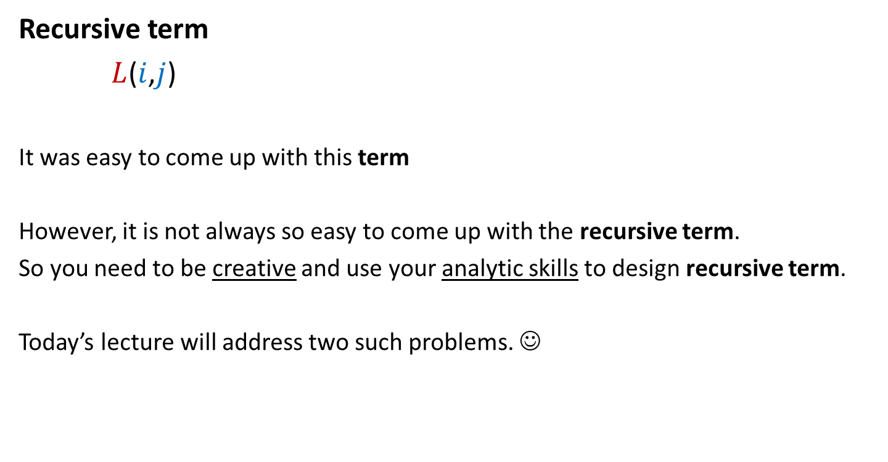
From Longest common subsequence problem
Recursive term
$L$($i$,$j$)
It was easy to come up with this term
However, it is not always so easy to come up with the recursive term.
So you need to be creative and use your analytic skills to design recursive term.
Today’s lecture will address two such problems. ☺
: The length of LCS of A[$1..i]$ and B[$1..j]$
because of linear structure of sequence.

Slide 5
OPTMAL Triangulation of a CONVEX POLYGON

Slide 6












Convex polygon
Representation: ?
How to store: ?
< $p_{i}$,…, $p_{j}$> : ?
< $p_{1}$,…, $p_{n}$>
Array
$$p_{i}$$
$$q$$
$$p_{n−2}$$
$$p_{3}$$
$$r$$
$$p_{2}$$
$$p_{n−1}$$
$$p_{n}$$
$$p_{1}$$
Polygon consisting of points $p_{i}$,…, $p_{j}$

Slide 7
Triangulation of a CONVEX POLYGON
Partitioning the polygon into disjoint triangles
$$p_{i}$$
$$p_{3}$$
$$p_{2}$$
$$p_{n−1}$$
$$p_{n}$$
$$p_{1}$$
, each defined by 3 points on the polygon

Slide 8
Triangulation of a CONVEX POLYGON
Partitioning the polygon into disjoint triangles
$$p_{i}$$
$$p_{3}$$
$$p_{2}$$
$$p_{n−1}$$
$$p_{n}$$
$$p_{1}$$
, each defined by 3 points on the polygon

Slide 9


Triangulation of a CONVEX POLYGON
Though there may be many triangulations,
but each has exactly
$n−2$ triangles.
Each side of the polygon
belongs to exactly $1$ triangle in a triangulation.
$$p_{i}$$
$$p_{3}$$
$$p_{2}$$
$$p_{n−1}$$
$$p_{n}$$
$$p_{1}$$

Slide 10
OPTMAL Triangulation of a CONVEX POLYGON

Slide 11


$ω$($i$,$j$,$k$) : weight of triangle formed by $p_{i}$, $p_{j}$, $p_{k}$.
Assumption: It takes O(1) time to compute $ω$($i$,$j$,$k$)
Cost of a triangulation : sum of the weight of $n−2$ triangles formed.
Aim: Compute triangulation of minimum cost.
$$p_{i}$$
$$p_{3}$$
$$p_{2}$$
$$p_{n−1}$$
$$p_{n}$$
$$p_{1}$$

Slide 12
Attempt 1
Let us count the number of all possible triangulations.
If it is polynomial,
we have a polynomial time algorithm
to compute optimal triangulation.

Slide 13







How many possible triangulations ?
Let us explore the triangles to which side ($p_{1}$, $p_{n}$) may belong in any triangulation.
$$p_{k}$$
$$p_{3}$$
$$p_{2}$$
$$p_{n−1}$$
$$p_{n}$$
$$p_{1}$$

Slide 14
How many possible triangulations ?
$$p_{k}$$
$$p_{3}$$
$$p_{2}$$
$$p_{n−1}$$
$$p_{n}$$
$$p_{1}$$

Slide 15
How many possible triangulations ?
$$p_{k}$$
$$p_{3}$$
$$p_{2}$$
$$p_{n−1}$$
$$p_{n}$$
$$p_{1}$$

Slide 16
How many possible triangulations ?
$$p_{k}$$
$$p_{3}$$
$$p_{2}$$
$$p_{n−1}$$
$$p_{n}$$
$$p_{1}$$

Slide 17
How many possible triangulations ?
$$p_{k}$$
$$p_{3}$$
$$p_{2}$$
$$p_{n−1}$$
$$p_{n}$$
$$p_{1}$$

Slide 18
How many possible triangulations ?
$$p_{k}$$
$$p_{3}$$
$$p_{2}$$
$$p_{n−1}$$
$$p_{n}$$
$$p_{1}$$

Slide 19

How many possible triangulations ?
$$p_{k}$$
$$p_{3}$$
$$p_{2}$$
$$p_{n−1}$$
$$p_{n}$$
$$p_{1}$$
Exactly $n−2$ triangles.

Slide 20
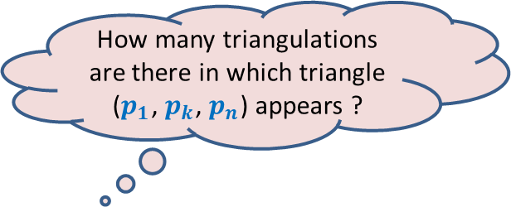


How many possible triangulations ?
$$F(n)$$
: The number of possible triangulations of polygon of $n$sides.
$$p_{k}$$
$$F\left(3\right)=1$$
$$p_{3}$$
$$p_{2}$$
$$p_{n−1}$$
How many triangulations are there in which triangle ($p_{1}$, $p_{k}$, $p_{n}$) appears ?
$$p_{n}$$
$$p_{1}$$
Exactly $n−2$ triangles.

Slide 21
How many possible triangulations ?
$$F(n)$$
: The number of possible triangulations of polygon of $n$sides.
$$p_{k}$$
$$F\left(3\right)=1$$
$$p_{3}$$
$$p_{2}$$
$$p_{n−1}$$
How many triangulations are there in which triangle ($p_{1}$, $p_{k}$, $p_{n}$) appears ?
$$p_{n}$$
$$p_{1}$$

Slide 22



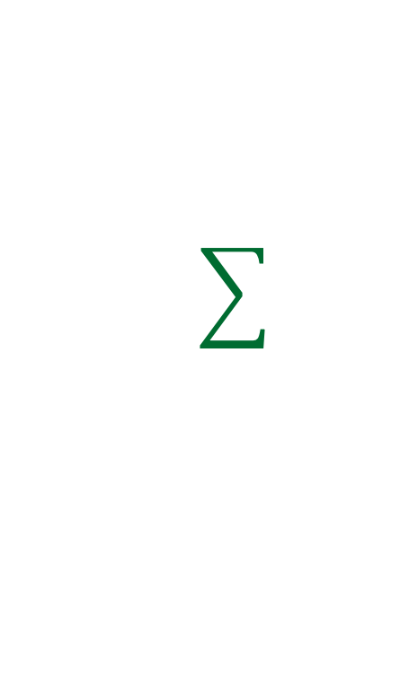








How many possible triangulations ?
$$F(n)$$
: The number of possible triangulations of polygon of $n$sides.
$$p_{k}$$
$$F\left(2\right)=1$$
$$F\left(3\right)=1$$
What about $F(n)$?
$$F(n−k+1)$$
$$F(k)$$
$$p_{3}$$
Exponential in $n$ ☹
$$p_{2}$$
$$p_{n−1}$$
Can you write a recurrence for this count ?
$$×$$
$$F(k)$$
$$F(n−k+1)$$
$$p_{n}$$
$$p_{1}$$
$$2≤k≤n−1$$
= # rooted binary trees on $n−2$ nodes
= ($n−2$)th Catalan number

Slide 23
There are exponential number of triangulations.
So we cannot afford to enumerate them to compute least cost triangulation.
But, ..
the insight we developed from the exercise of counting the no. of triangulations
will help us design the recursive formulation for the least cost triangulation.
Spend some time working on your own before proceeding further. ☺

Slide 24



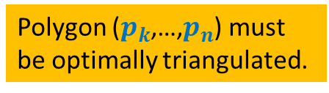
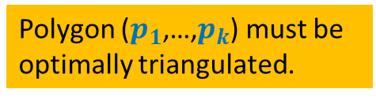
How to compute optimal triangulation ?
Question: If the opt. triangulation has triangle ($p_{1}$, $p_{k}$, $p_{n}$), what can we infer ?
$$p_{k}$$
$$p_{3}$$
Polygon ($p_{1}$,…,$p_{k}$) must be
optimally triangulated.
Polygon ($p_{k}$,…,$p_{n}$) must
be optimally triangulated.
$$p_{2}$$
$$p_{n−1}$$
Can you give a recursive formulation for the problem ?
What will be the recursive term ?
How many parameters ?
$$p_{n}$$
$$p_{1}$$
Otherwise, we can replace it with optimal triangulation of ($p_{1}$,…,$p_{k}$) to get a triangulation of ($p_{1}$,…,$p_{n}$) with cost less than the optimal.
A contradiction !
Otherwise, we can replace it with optimal triangulation of ($p_{k}$,…,$p_{n}$) to get a triangulation of ($p_{1}$,…,$p_{n}$) with cost less than the optimal.
A contradiction !
Spend some time pondering over these questions before moving on…

Slide 25
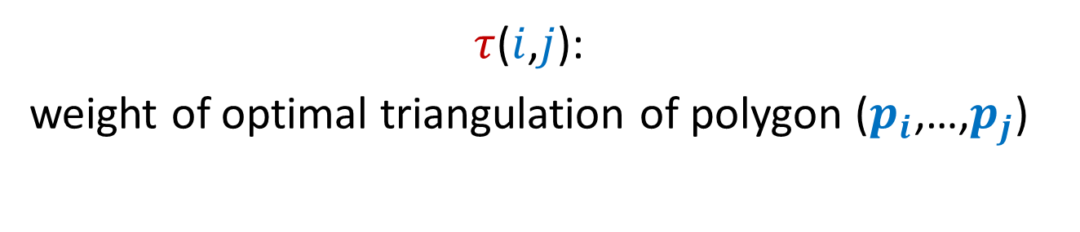
Recursive formulation of OPTMAL Triangulation
$τ$($i$,$j$):
weight of optimal triangulation of polygon ($p_{i}$,…,$p_{j}$)

Slide 26








Recursive formulation for $τ$($i$,$j$)
Base case:
$τ$($i$,$i+1$) = 0
For $j>i+1$
$τ$($i$,$j$) =
$$\min_{?}{? }$$
$$p_{k}$$
Generic case:
$$p_{j}$$
($τ$($i$,$k$) $+τ\text{(}k,j\text{)+}ω\text{(}i,k,j\text{)}$ )
$i$<$k$< $j$
$$p_{i+1}$$
$$p_{i}$$

Slide 27
Recursive ALGORITHM of OPTMAL Triangulation

Slide 28
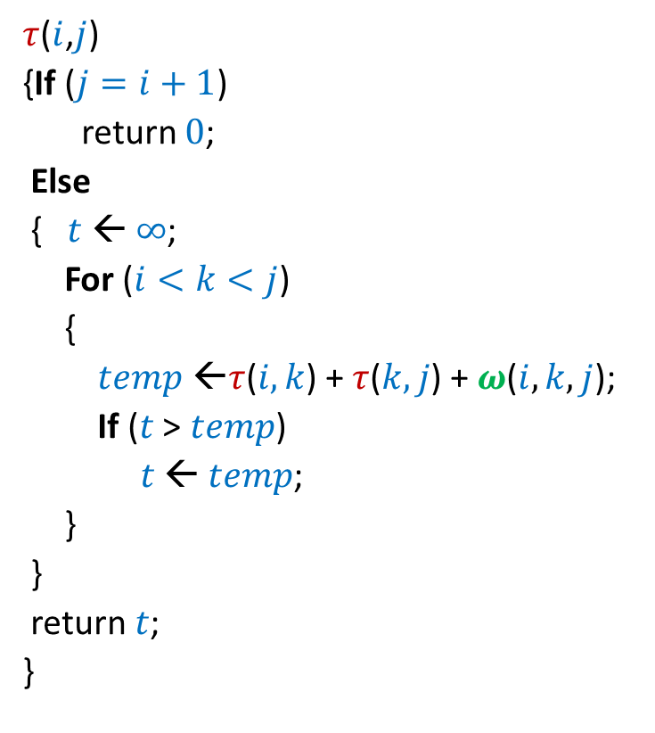

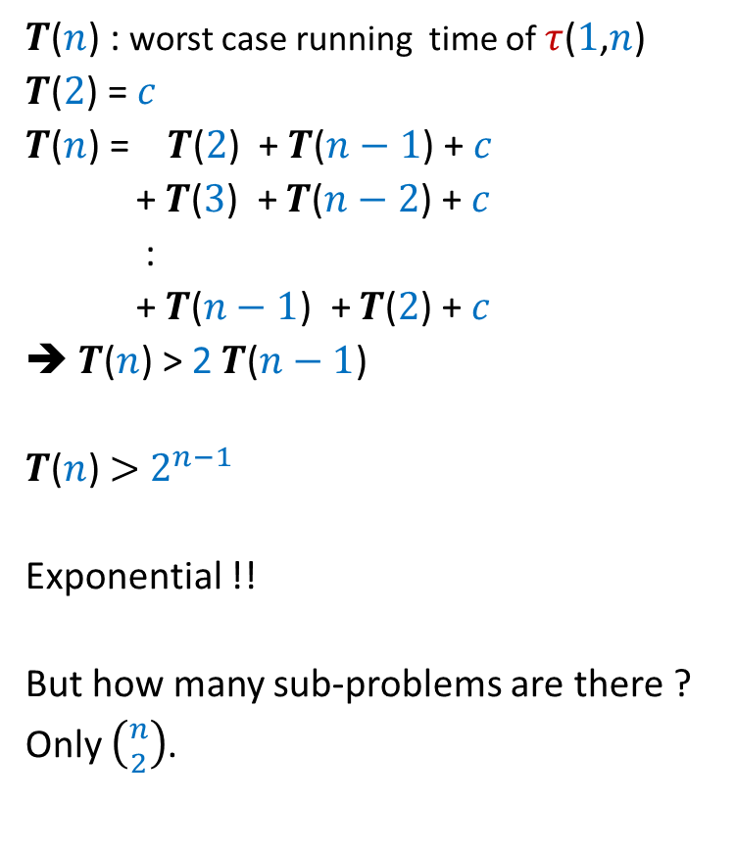
Recursive algorithm for $τ$($i$,$j$)
$τ$($i$,$j$)
{If ($j=i+1$)
return $0$;
Else
{$t$ ← $∞$;
For ($i<k<j$)
{
$temp$ ←$τ$($i,k$) + $τ$($k,j$) + $ω$($i,k,j$);
If ($t$ > $temp$)
$t$ ← $temp$;
}
}
return $t$;
}
$T$($n$) : worst case running time of $τ$($1$,$n$)
$T$($2$) = $c$
$T$($n$) = $T$($2$) + $T$($n−1$) + $c$
+ $T$($3$) + $T$($n−2$) + $c$
:
+ $T$($n−1$) + $T$($2$) + $c$
➔ $T$($n$) > 2 $T$($n−1$)
$T$($n$) $>$ $2^{n−1}$
Exponential !!
But how many sub-problems are there ?
Only $\left({n \atop 2}\right)$.

Slide 29






Recursive algorithm for $τ$($i$,$j$)
$T$[$i$,$j$] = $τ$($i$,$j$)
$τ$($i$,$j$)
{If ($j=i+1$)
return $0$;
Else
{$t$ ← $∞$;
For ($i<k<j$)
{
$temp$ ←$τ$($i,k$) + $τ$($k,j$) + $ω$($i,k,j$);
If ($t$ > $temp$)
$t$ ← $temp$;
}
}
return $t$;
}
$$n$$
0
0
0
0
0
0
0
0
0
$$i$$
0
…
0
2
0
1
0
1 2 ... $n$
$$j$$
$$T$$
Homework: Write a neat and efficient iterative algorithm. We shall discuss it in next class.

Slide 30
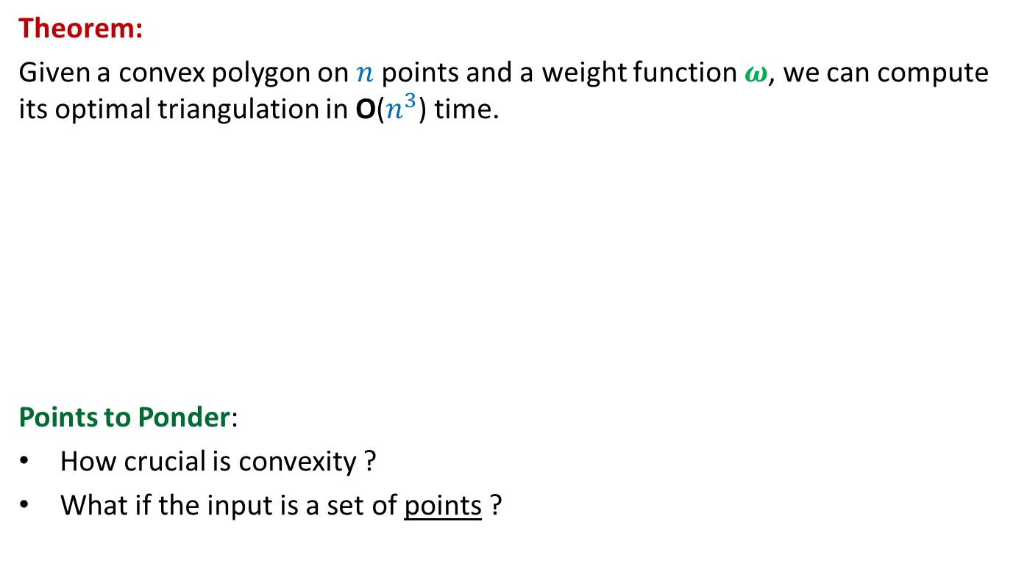

Iterative algorithm for $τ$($i$,$j$)
Theorem:
Given a convex polygon on $n$points and a weight function $ω$, we can compute its optimal triangulation in O($n^{3}$) time.
Points to Ponder:
How crucial is convexity ?
What if the input is a set of points ?
Not much.
No polynomial time algorithm till date ☹

Slide 31
OPTIMAL SUBSTRUCTURE PROPERTY
A PROPERTY
underlying every
Dynamic Programming based algorithm

Slide 32

Longest Common Subsequence
Lemma1: If $a_{n}=b_{m}$then
LCS($n$,$m$) = LCS($n−1$,$m−1$) ::${ a}_{n}$
Lemma2: If $a_{n}≠b_{m}$then
LCS($n\text{,}m$) is either LCS($n$,$m−1$) or LCS($n−1$,$m$)

Slide 33
Optimal triangulation of a convex polygon
$τ$($i$,$i+1$) = 0
For $j>i+1$
$τ$($i$,$j$) =
$$\min_{?}{? }$$
$$p_{k}$$
$$p_{j}$$
($τ$($i$,$k$) $+τ\text{(}k,j\text{)+}ω\text{(}i,k,j\text{)}$ )
$i$<$k$< $j$
$$p_{i+1}$$
$$p_{i}$$

Slide 34
OPTIMAL SUBSTRUCTURE PROPERTY
“Optimal solution of a problem contains within it
optimal solution for its smaller instances as well”.
Note:
This Property is Essential for every dynamic programming based algorithm

Slide 35
Shortest pathS in a graph
In presence of negative edge weights

Slide 36
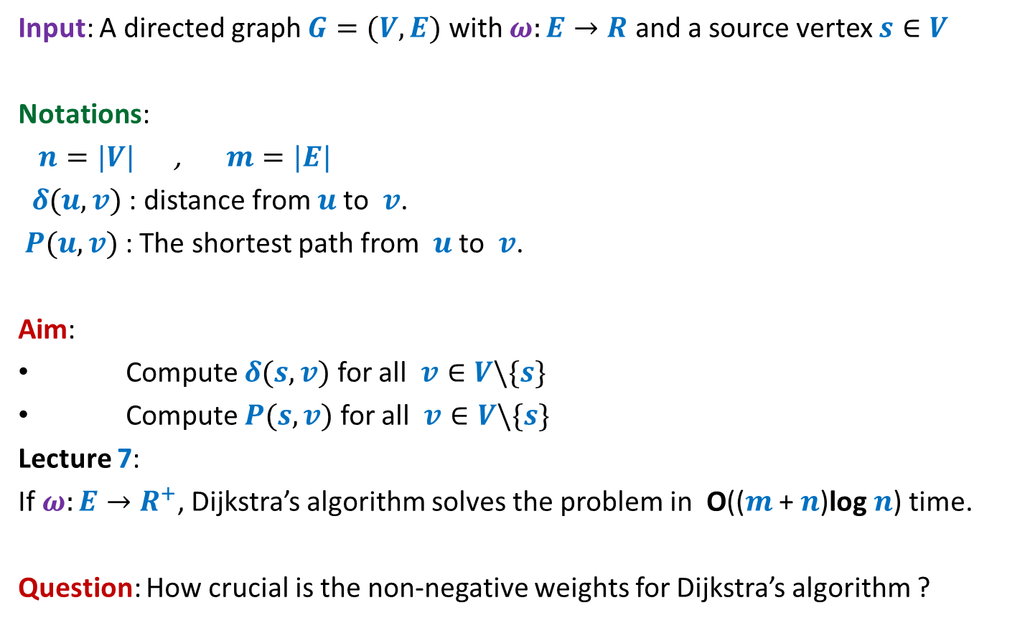
Problem Definition
Input: A directed graph $G=(V,E)$ with $ω:E→R$ and a source vertex $s∈V$
Notations:
$n=|V|$ , $m=|E|$
$δ(u,v)$ : distance from $u$to $v$.
$P(u,v)$ : The shortest path from $u$to $v$.
Aim:
Compute $δ(s,v)$ for all $v∈V\backslash \{s\}$
Compute $P(s,v)$ for all $v∈V\backslash \{s\}$
Lecture 7:
If $ω:E→R^{+}$, Dijkstra’s algorithm solves the problem in O(($m$ + $n$)log $n$) time.
Question: How crucial is the non-negative weights for Dijkstra’s algorithm ?

Slide 37
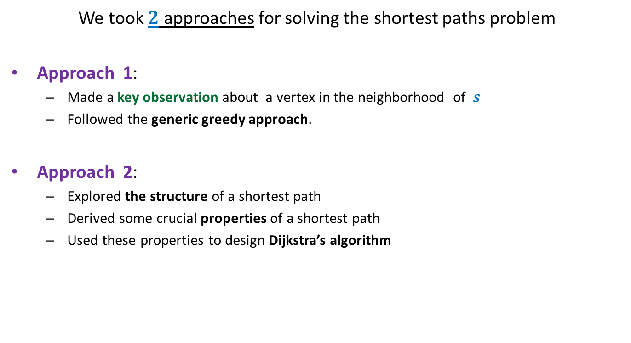
Revisiting Lecture 7
We took $2$ approaches for solving the shortest paths problem
Approach 1:
Made a key observation about a vertex in the neighborhood of $s$
Followed the generic greedy approach.
Approach 2:
Explored the structure of a shortest path
Derived some crucial properties of a shortest path
Used these properties to design Dijkstra’s algorithm
Let us explore how crucial was the role of “non-negative edge weights” in these approaches.

Slide 38












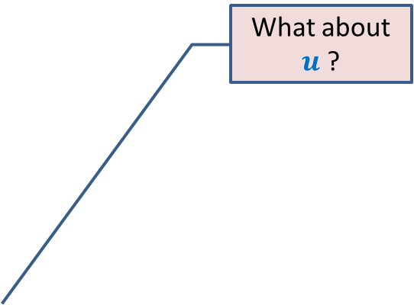
Approach 1
What about $u$ ?
Question: Can we be certain about the distance from $s$ to any vertex in this picture ?
Answer: NO.☹
$$z$$
$$10$$
$$v$$
G
$$12$$
$$7$$
$$x$$
$$s$$
$$−3$$
$$5$$
$$u$$
$$y$$

Slide 39

Approach 1
$$z$$
$$10$$
$$v$$
G
$$12$$
$$7$$
$$x$$
$$s$$
$$−3$$
$$5$$
$$u$$
$$y$$
$$−16$$
Approach 1 fails ☹

Slide 40
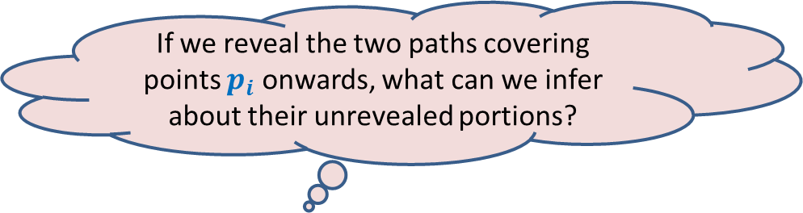
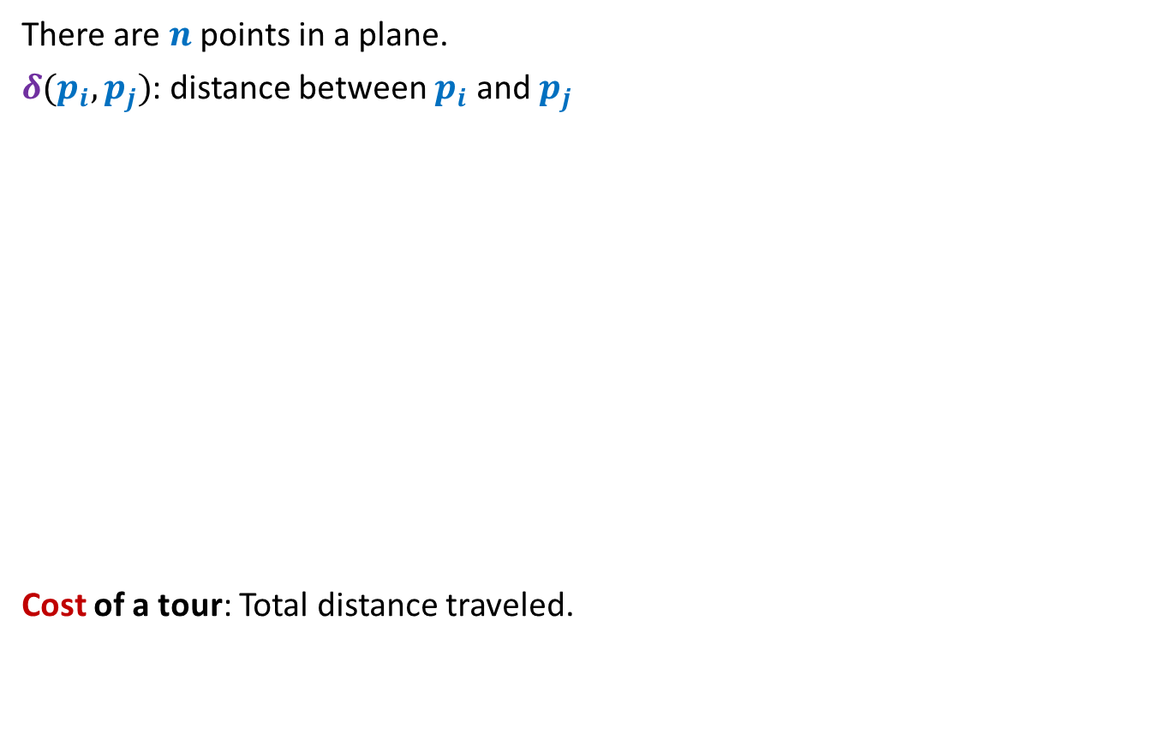




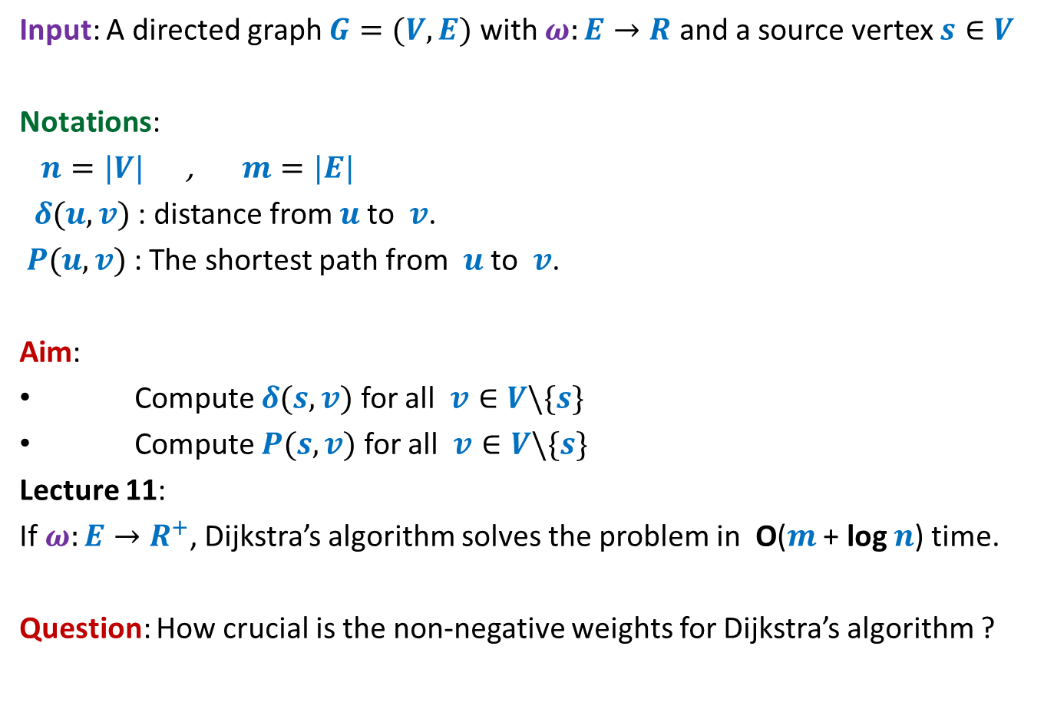
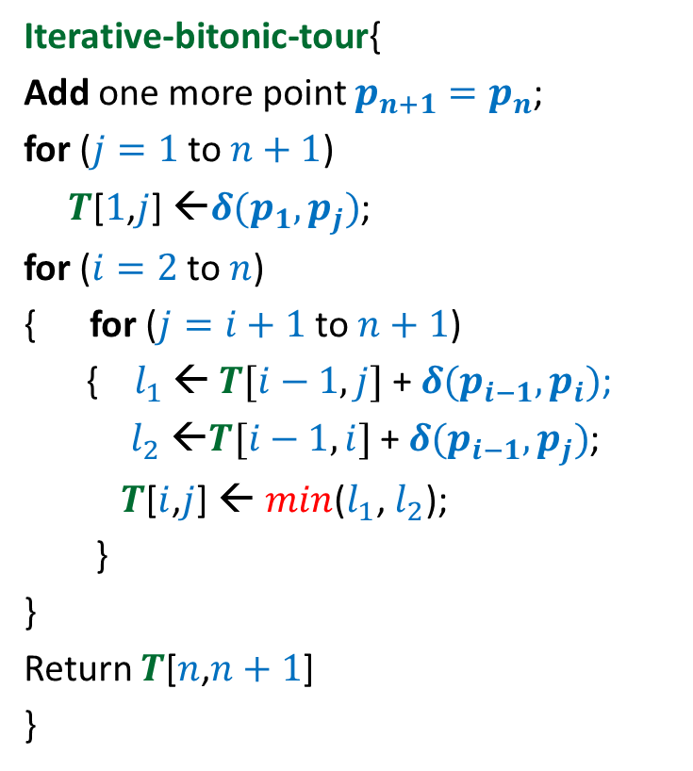

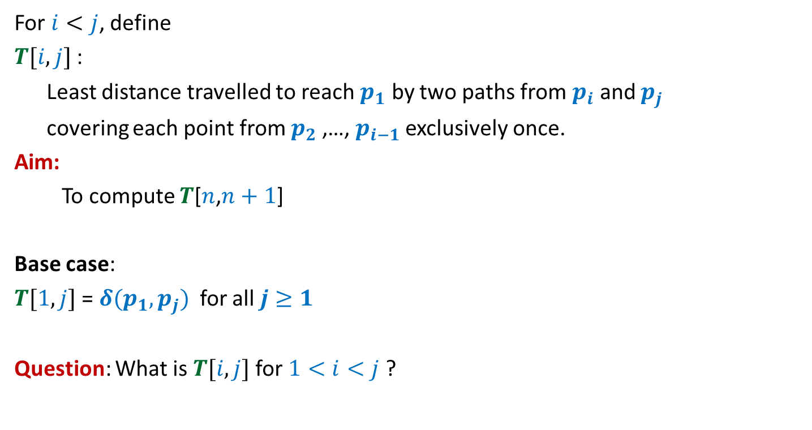

What properties does Dijkstra’s algorithm exploit ?
Approach 2
Property 1: Any subpath of $P(s,y)$ is also a shortest path.
Proof: If $Q$ is not shortest path to $x$,
replace it by a shorter path from $s$ to $x$.
This will give us a path to $y$, which is shorter than $P(s,y)$.
This contradicts that $P(s,y)$ is the shortest path to $y$.
If $P\left(s,y\right)=Q∷(x,y)$, then $Q$ is the shortest path from $s$ to $x$.
$$<α$$
$$<α$$
$$P(s,y)$$
$$s$$
$$u$$
$$v$$
$$x$$
$$y$$
$α$= Length of $Q$
$$Q$$
This proof given in Lecture 7 is incomplete. Students were asked to work on it as homework. Hardly 25% students even attempted in the last 2-3 weeks.

